Slide 1

BUSINESS ANALYSIS of ORANGE S.A.
Kushagra Airen - x22200878
Samradni Ranganath Bharadwaj - x22214801
Avni Rathi - x22182918

Slide 2

INTRODUCTION
Orange S.A. is a France-based multinational company in the telecommunications sector. It has more than 250 million customers worldwide, more than 80,000 employees in France, and 59,000 employees in other parts of the world.
The company wants to increase its customer base in the United States, especially in California.
Orange S.A. wants to adapt DA and Business Intelligence to increase their customer base, identify churn rate reasons, and achieve long-term goals.
The analysis will help management take informed decisions and will have a better idea of how to target the potential customers.

Slide 3
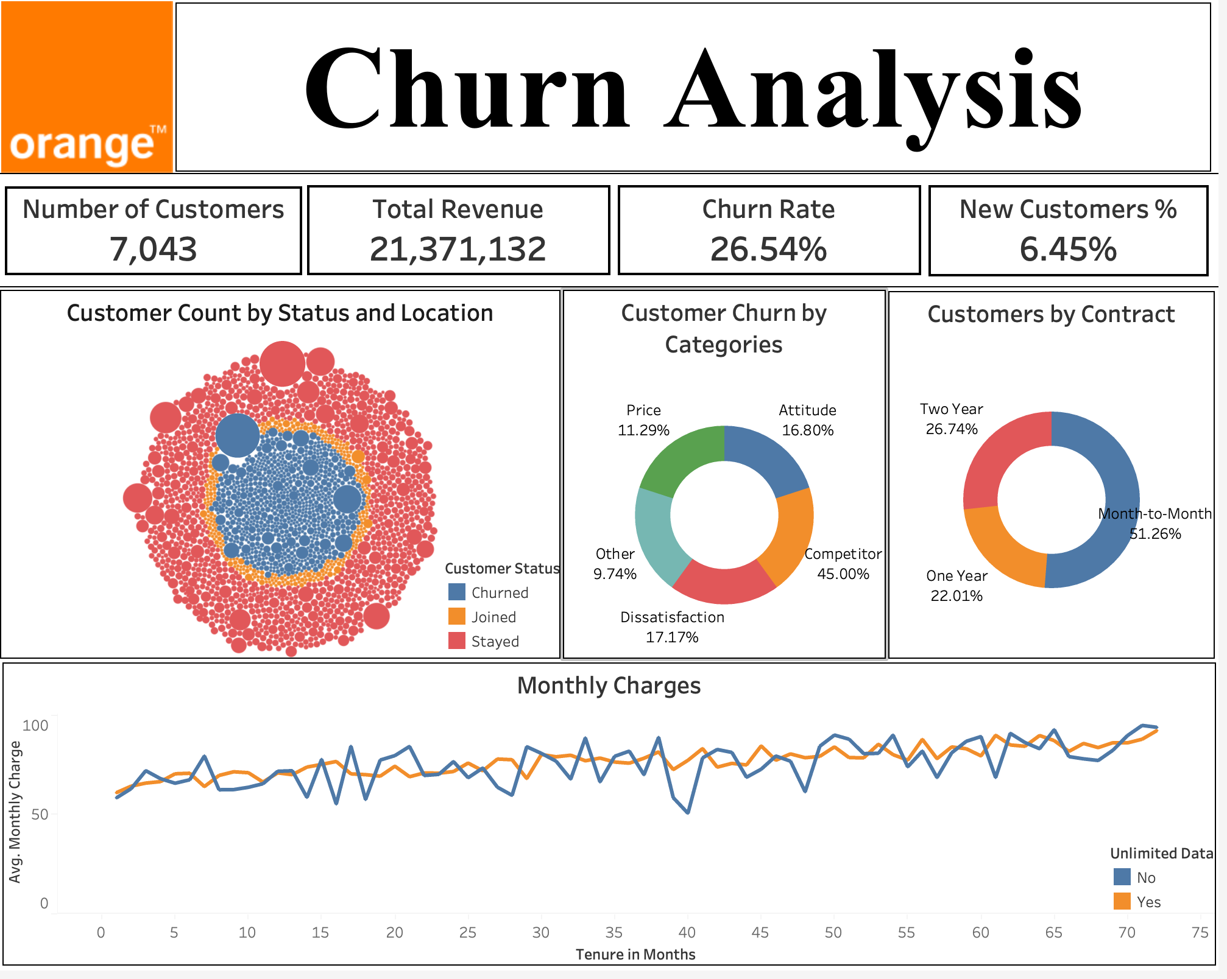
Enter title here
Enter title here
Click here to add content of the text，and briefly explain your point of view

Slide 4
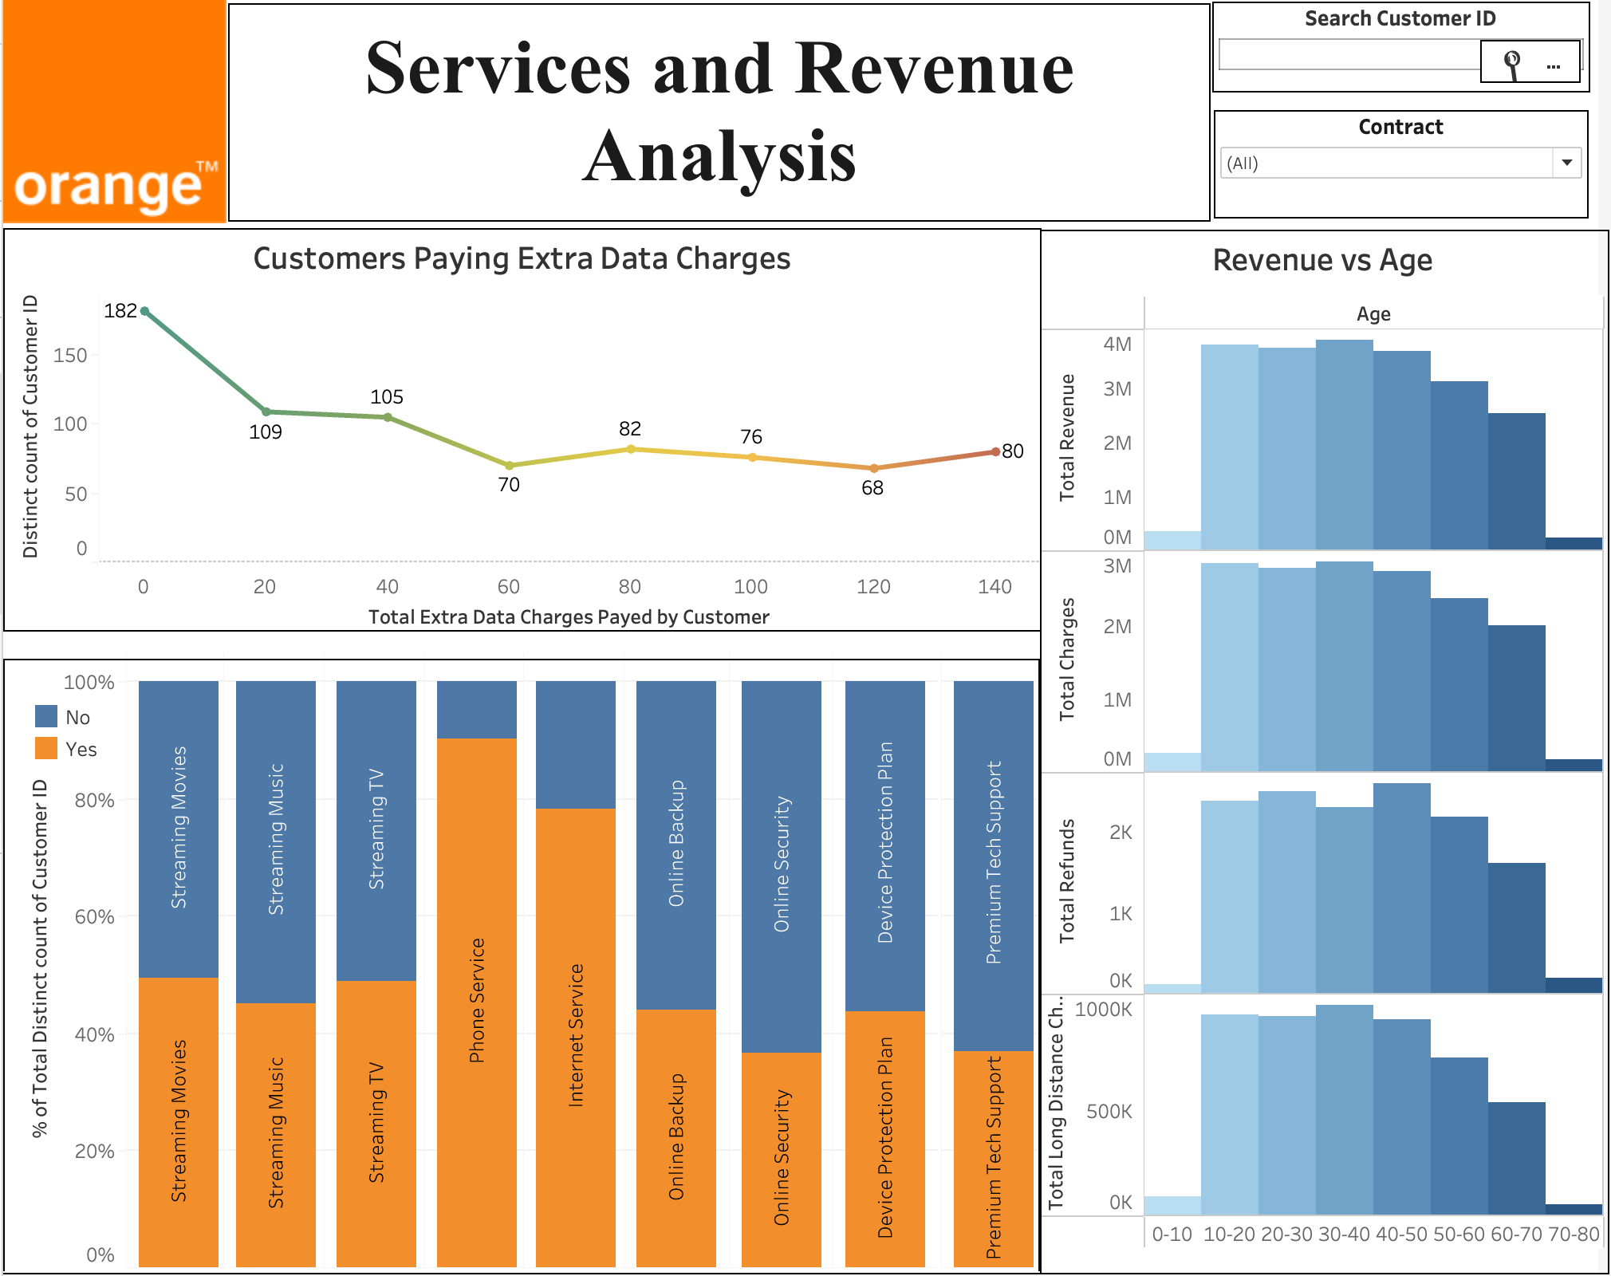

Slide 5
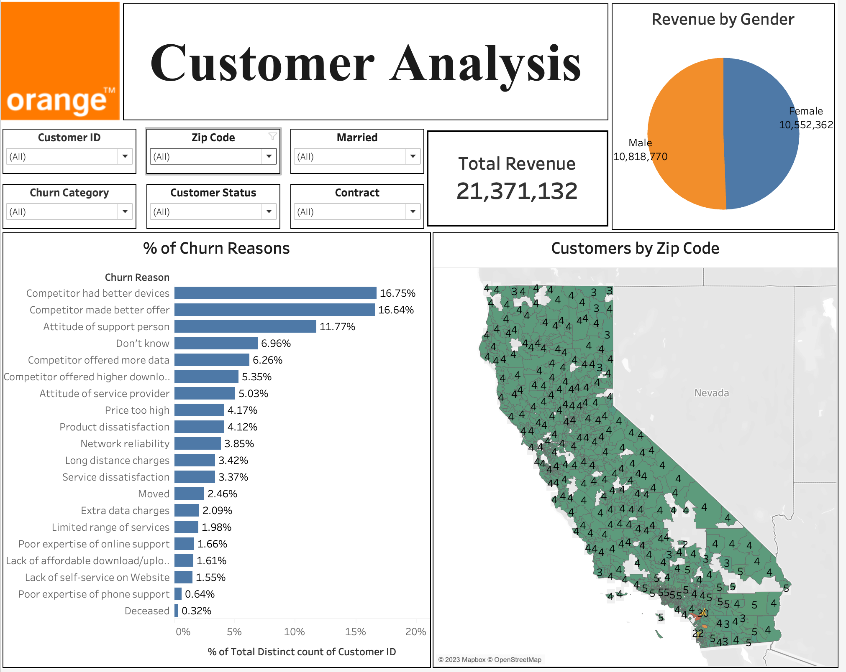

Slide 6
CONCLUSION
Customers with two year contracts should be reached out frequently for their feedbacks as they are the customers who have the maximum impact on revenue (generating 9,036,849). There is a 2.55% churn rate for the two year contract customers.
Company can rethink about the services like Premium Tech Support, Online Security and Online Backup if they are not subscribed by customers.
The company’s main customer base is within the age group of 10-30, which is mostly students or young professionals, for which better offers with discounted prices should be offered to them
The average churn rate expected in a telecom company is around 30-35%, compared to Orange S.A., which is performing preferably well with a 26.54% churn rate, which can be lowered down further by taking the suggested steps.

Slide 7
THANK YOU

